Slide 1

Forecasting Real Estate Prices With Time Series Analysis
Dominic Garcia

Slide 2
Agenda
Business Problem
Data
Process
Results & Recommendations
Future Work

Slide 3
Business Problem
Recent census data suggests that Arizona is one of the 5 fastest growing states in the nation, in terms of both raw numbers & percent growth.
Currently, Simon Property Group owns 3 retail spaces in the state and would like to develop another.
Other states with similar population counts (6.5 - 8.5 million compared to Arizona's 7.15 million) have anywhere from 4-14 properties owned by the group.
Since 2 of their Arizona properties are located in the Phoenix metro area, their primary focus is on the state’s next biggest metro: Tucson.

Slide 4
Business Problem
As part of a team hired by Simon Property, my task is to use time series analysis of data from Zillow to forecast which zip codes out of the most populous in Tucson will have the best Return on Investment.
Even though the Zillow data covers housing (and not commercial) real estate, a positive ROI value for residential real estate will be a useful indicator of:
A projected increase in retail spending & economic growth.
A proof of concept for future work with commercial data.

Slide 5
Data
The main dataset used in this project is a collection of average monthly real estate prices across US zip codes, provided by Zillow.
For this project, though, the scope of this dataset was narrowed down to:
Zip codes within the state of Arizona.
Zip codes within the metro of Tucson that aren’t near Simon Property’s Tucson Premium Outlets.
To obtain population estimates for each zip code of interest, additional data was sourced from https://www.unitedstateszipcodes.org/.

Slide 6
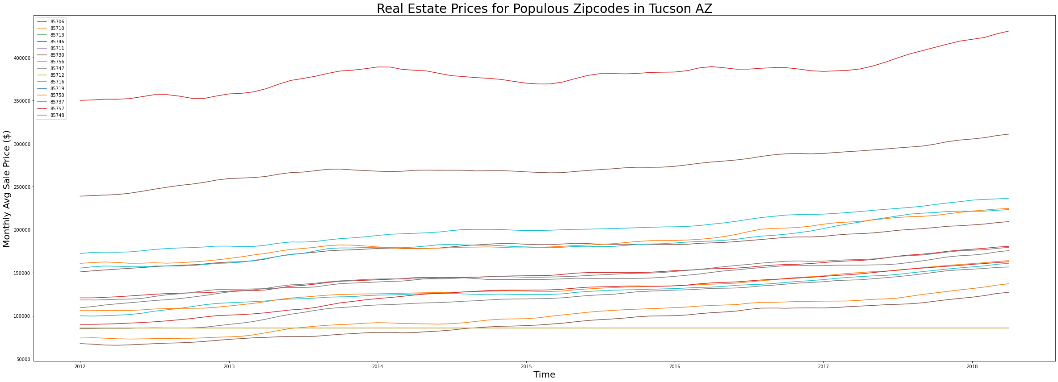
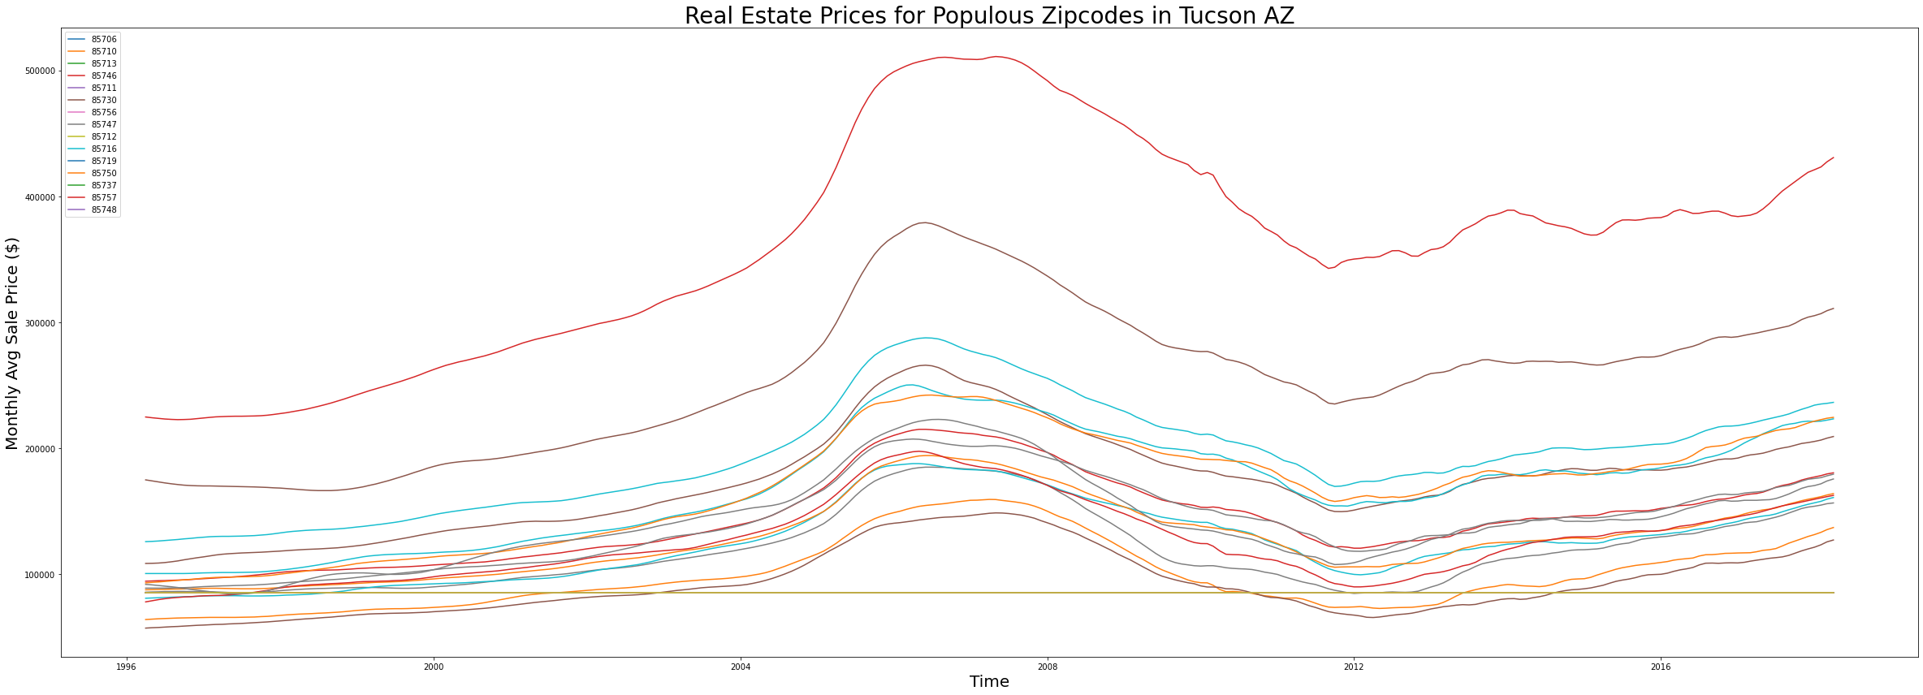
Process
Based on population estimates, pick the 15 most populous zip codes in Tucson metro as initial pool of candidates for development location.
Create ARIMA time series model for price data of each zip code from 2012 onward.
Use these models to forecast future real estate prices in each zip code.
Calculate per-zip ROI projections at 1 month, 6 months & 12 months ahead.

Slide 7
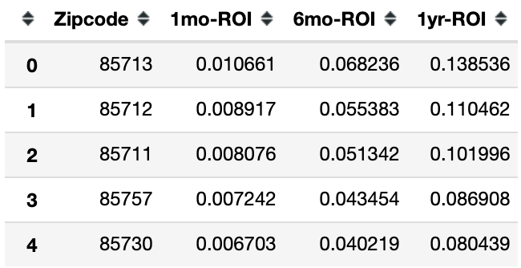
Results & Recommendations
As seen in the table, the top five Tucson zip codes to invest in (based on 1, 6 or 12-month ROI forecasts) are:
85713 (13.9% 12mo)
85712 (11% 12mo)
85711 (10.2% 12mo)
85757 (8.7% 12mo)
85730 (8% 12mo)

Slide 8
Results & Recommendations
Based on these results, my recommendation for Simon Property Group is to begin developing commercially in 85713.
ROI projections:
1-month: +1.06% (next best zip +0.89%)
6-month: +6.82% (next best zip +5.53%)
12-month: +13.85% (next best zip +11.04%)

Slide 9
Future Work
Given more time with the job, I would:
Acquire commercial data to corroborate the zip code choices made.
Explore more of the 55 zip codes within the Tucson metro.
Inspect other metros within the state of Arizona, such as Prescott Valley & Lake Havasu City.

Slide 10
Questions?
Github: https://github.com/dl-gd
Email: dlgarcia.017@gmail.com

